Slide 1

The Illinois Board of Higher Education:
A Brief History
Harry Berman, Ph.D. • October 25, 2019
Notes:
Long career at UIS as a faculty member and administrator
In my first and longest administrative position (1994-2004), I had responsibility for academic planning and also served as graduate dean.
My responsibilities during those years included working with the IBHE to get UIS’s proposals for new programs approved, that is, to secure approval from the IBHE staff and, ultimately, from the board itself.
It’s hard to convey the hours of meetings, deliberations, and compromises that took place on campus to get any given proposal developed on campus and approved by the relevant faculty committees, then by the Campus Senate, and then by the University of Illinois Board of Trustees.
So I will confess that an additional required approval by the IBHE felt to me in those years totally unnecessary. It felt like purely bureaucratic rigmarole
After all, my entire focus was on my campus and advancing the campus in ways that we had determined were needed increase enrollments and the quality of our academic offerings.
Following my years working on academic planning, I served as provost for five years and then interim chancellor for one, at which point I decided it was time to retire. As provost and interim chancellor, I gained more of a perspective on the IBHE’s work, but I think it’s fair to say, I still was not a fan.
Imagine my surprise when a year into my retirement I got a call from Carrie Hightman, the then Chair of the IBHE board, asking if I would consider serving as Interim Executive Director of the agency. I had not planned to come out of retirement, I had not been looking for work, but after discussing the opportunity with my wife and a couple of folks whose opinion I trusted, I agreed to take on the responsibility.
Originally, the commitment that was described to me was for 4-6 months. It ended up being for 14 months. That’s the way interim positions often work out
But – and here’s the point --- during my time as executive director (the board removed the “interim” from my title after several months), I gained enormous respect for the agency’s work and its distinguished history – and for the Illinois Higher Education System
I want to share with you some of what I have learned of that history
From the outset I want to acknowledge the valuable resources for this history found at the Abraham Lincoln Presidential Library Oral History Project, the Illinois State Library, UIS oral history collection, and informative and amusing conversations with Dick Wagner, IBHE executive director from 1980 to 1998.
Finally, I’m humbled to be making this presentation with Buzz Shaw in the audience. Dr. Shaw knows first hand much of the history I’m going to be talking about.
You’re aware that the IBHE is a coordinating board, not a governing board. So when did the idea of the need for ”coordination” arise and what have been the major milestones in the agency’s history?

Slide 2
Higher Education Landscape
Pre-1961
Notes:
University of Illinois
1867 –
Originally, Illinois Industrial University
one of the 37 universities created under the first Morrill Land-Grant Act
Medical School in Chicago with roots that go back to 1882
After WWII, operated at Navy Pier – Chicago Undergraduate Division of University of Illinois established in 1946 at Navy Pier –2 yr program

Slide 3

Higher Education Landscape
Pre-1961
Delyte W. Morris
Notes:
SIU
1869
Southern Illinois Normal College
The university continued primarily as a teacher's college until Delyte W. Morris took office as president of the university in 1948. Morris was SIU's longest-serving president (1948–1970).^{[11]} During his presidency, Morris transformed SIU, adding Colleges of Law, Medicine and Dentistry. Southern Illinois University grew rapidly in size from 3,500 to over 24,800 students between 1950 and 1991

Slide 4
Higher Education Landscape
Pre-1961
Most of remainder of public institutions were teachers colleges.
Notes:
Illinois State 1857 – Illinois State Normal University – Oldest public university in Illinois
Eastern 1895 – Eastern Illinois State Normal School
Western 1899 – Western Illinois State Normal School
Chicago Teachers Colleges
In terms of governance, it’s interesting that there was a Teachers College Board – a governing board – from 1937 to 1965
And Junior Colleges

Slide 5
Higher Education Landscape
Pre-1961
Major private universities
Notes:
Major private universities in Chicago

Slide 6
Higher Education Landscape
Pre-1961
Long tradition of excellent private colleges
1837
1829
1898
1848
1860
1850
1846
Notes:
Illinois has long tradition of private colleges. Here is a sampling, along with the dates of their founding.
Illinois College – 1829 founded by the Illinois Band, students from Yale who traveled west to found new colleges. Presbyterian and Congregationalist roots
Knox – 1837 Knox Manual Labor College – anti-slavery reformers
MacMurray – 1846 Methodist, Women’s College
Eureka – 1848 Abolitionists
Illinois Wesleyan – 1850 Methodists
Quincy – 1860 Roman Catholic
DePaul – 1898 – Roman Catholic

Slide 7
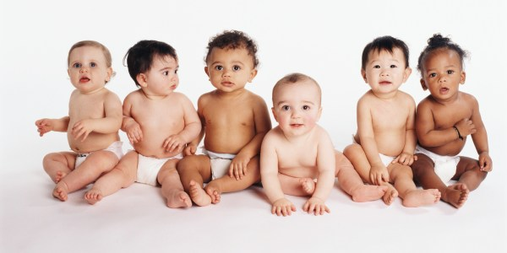
Higher Education Landscape
Post WWII and Pre-1961
Notes:
Aren’t they cute?? Who can resist babies
We’re now in the period after WWII and the Baby Boom, which lasted from (1947-1964)
The U.S. birthrate exploded after World War II. From 1944 to 1961, more than 65 million children were born in the United States.^{[3]} At the height of this baby boom, on average a child was born every seven seconds.. Factors that contributed to the baby boom consisted of young couples who started families after putting off marriage during the War, government encouragement of growth of families through the aid of GI benefits, and popular culture that celebrated pregnancy, parenthood, and large families.
IBHE BORN OUT OF A DEMOGRAPHIC CHALLENGE

Slide 8
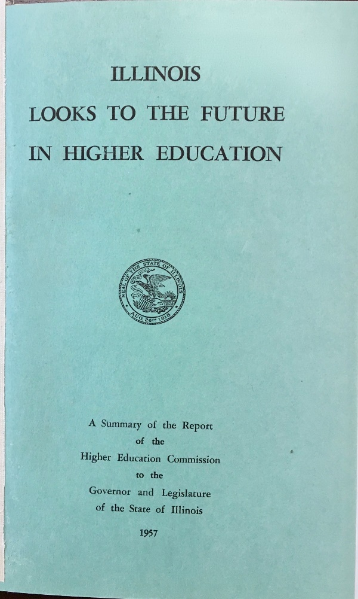
Higher Education Landscape
Post WWII and Pre-1961
Governor Stratton
and Commission
on Higher Education
Lenox R. Lohr, Chair
Richard Browne,
Vice Chair
William G. Stratton
Governor 1953-1961
Notes:
In 1954 the legislature passed and Governor Stratton signed into law a bill creating a task force to study and make recommendations on where higher education in Illinois should be headed.
The task force consisted of 16 members appointed by Governor Stratton.
Included Legislators and College and University Presidents
Lenox Lohr – President of Museum of Science and Industry
Richard Browne – Executive Officer of Teachers College Board
Statement of philosophy drafted by Delyte Morris and Richard Browne and adopted by the commission
The general increase in population and the new social and economic demands for educational service in the immediate future will place an unprecedented load upon all institutions of higher education. The state of Illinois is confronted with the necessity for planning immediately the proper development of proper resources for higher education.
Through education, man maintains a stature above that of other creatures. The degree of man’s educational enlightenment determines the degree to which that stature is higher; ultimately, it determines the permanence of his society as well.” (p. 6)
________________
Projected a doubling of the college-age population between 1950 and 1977.
Urgent need for educated citizens.
Scientists and Engineers
Teachers
Trained personnel in the social sciences and the humanities
[Possibly read the 10 Beliefs (p.7) COPY FROM PHOTO]
Also, (p.7) ”Although the Commission was created by the state of Illinois, the charge given it by no means limited the scope of its attention to institutions supported by the state. On the contrary, the Act implies that both the public and private institutions in the state must be viewed as a single program of higher education. Regardless of the differences in support and control , together they provide the resources by which Illinois makes post-secondary education available to her youth.”

Slide 9
Higher Education Landscape
Post WWII and Pre-1961
The general increase in population and the new social and economic demands for educational service in the immediate future will place an unprecedented load upon all institutions of higher education. The state of Illinois is confronted with the necessity for planning immediately the proper development of proper resources for higher education.
Through education, man maintains a stature above that of other creatures. The degree of man’s educational enlightenment determines the degree to which that stature is higher; ultimately, it determines the permanence of his society as well.
Illinois Looks to the Future: Report of the Commission on Higher Education, 1957, p.6

Slide 10
Major Recommendations of 1957 Commission on Higher Education Report
Extension of public junior colleges
State-wide scholarships
Coordination of publicly supported higher education
Notes:
Regarding junior colleges: The report provided a strong endorsement for the expansion of PUBLIC junior colleges along with a small but very significant shift in terminology in a section of the report called “The COMMUNITY junior college.”
The report’s recommendations were very influential in shaping the legislation that created the IBHE and set the stage for the establishment of the IBHE and the remarkable expansion of higher education that took place in the 1960s

Slide 11
Board of Higher Education Formed in 1961
To coordinate higher education in Illinois
Linchpins of IBHE’s influence:
  Authority to approve all new public colleges and all new programs at public universities and community colleges.
  Authority to make annual budget recommendations for higher education.
Notes:
COORDINATION: The coordination mandate sets the stage for master planning
The linchpins of the IBHE's influence were:
AUTHORITY TO APPROVE: This is the consumer protection and quality assurance function
BUDGET: While not mandatory that these recommendations be accepted, for many years Governors and General Assembly often relied heavily on those recommendations.

Slide 12
Milestones
Master Plans – Phases I – III
PQP
Higher Education Reorganization Act
Measuring Up 2000
Illinois Public Agenda
Pension Crisis and “Real” Budget Reduction
Notes:
Out of a history that spans nearly 60 years, I’ve identified 6 milestones that I think board members should be aware of. This is an idiosyncratic list. I suppose other people who chronicled the IBHE’s history might elevate some other milestones for consideration, but this is my list.

Slide 13
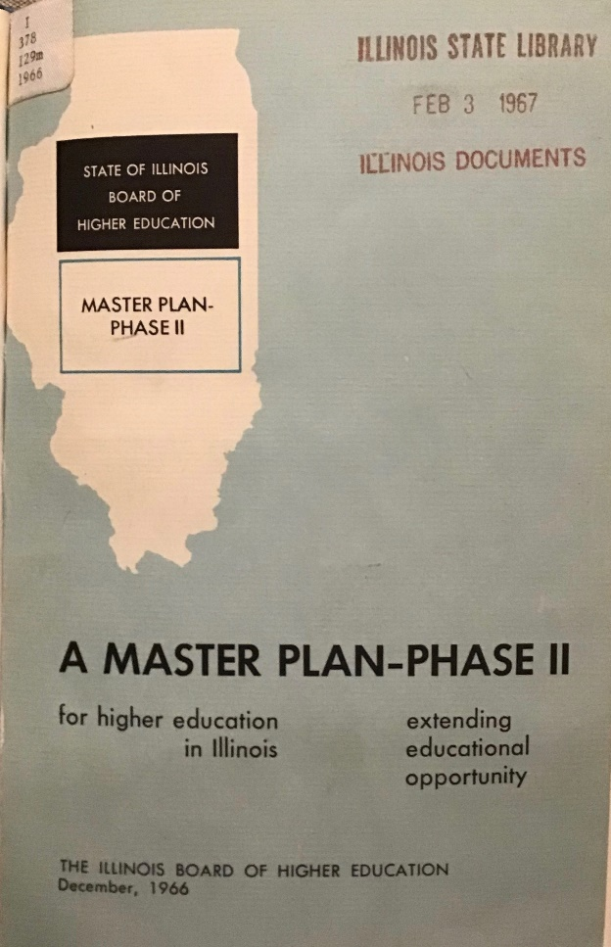
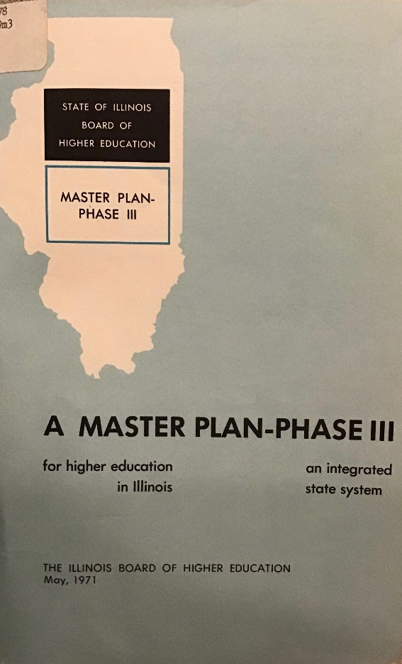
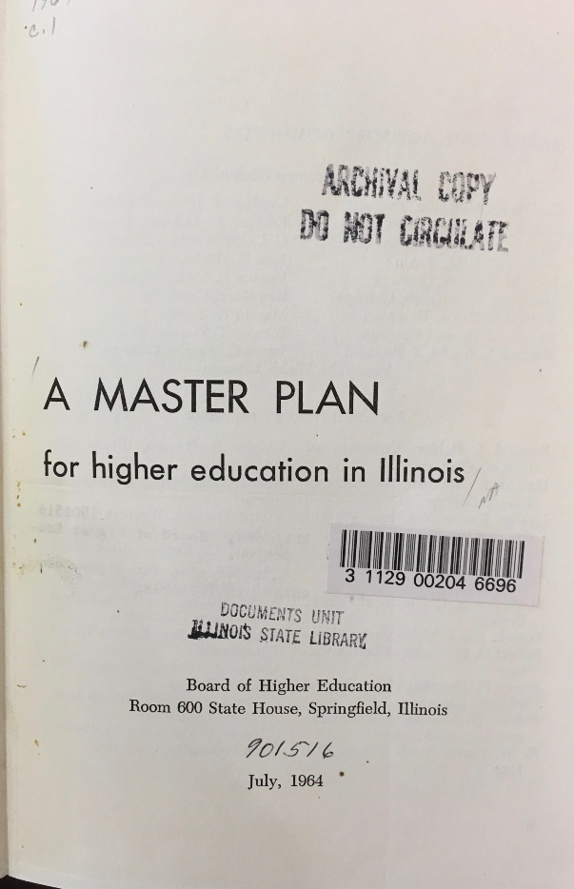
Milestones
1964-71
Master Plans: Phases I-III
Notes:
The first milestone was the master planning that occurred in three phases between 1964 and 1971.
These reports spanned the Kerner administration (1961-1968) and the Ogilvie Administration (1969-1973)
What was accomplished in that relatively short period of time was nothing short of the higher ed equivalent of the BIG BANG

Slide 15
Milestones
1964-71
Master Plans – Phases I-III
Established statewide system of community colleges
Created U of I Chicago Circle Campus and SIUE
Transformed Chicago Teachers Colleges into CSU and NEIU as state universities
Launched 2 new public universities
Expanded health education
Created Board of Governors and Board of Regents
Initiated Monetary Award Program (MAP)
Notes:
Community Colleges doubled from 23 campuses to 48
Funding provided for development of Chicago Circle campus as part of UI and for SIUE as a campus of SIU
Two teachers colleges had been run in Chicago by CPS. Both were taken over by the state and turned into state universities: Chicago Teachers College North became Northeastern Illinois University and Chicago Teachers College South became Chicago State University
In 1969, two entirely new universities launched: Governors State University 30 miles south of Chicago near Park Forest, and Sangamon State University in Springfield
Big expansion of Health Education: SIU School of Dental Medicine in Alton and SIU School of Medicine in Carbondale/Springfield, as well as support for programs in nursing, optometry, pharmacy. UI established medical campuses in Peoria, Rockford, and Champaign
Created Board of Governors and Board of Regents as systems - and led to the governance structure known as the system of systems
Expansion of Illinois state scholarships evolved to become a need-based program and expanded to private institutions on the argument that they had capacity
Decade of 1960s: Two main themes of expanding CAPACITY and ensuring AFFORDABILITY

Slide 16
System of Systems
University of Illinois
Southern Illinois University
Board of Governors
Board of Regents
Illinois Community College Board
Illinois Student Assistance Commission
Notes:
By the early 1970s, Illinois Higher Education was organized into a systems of systems Five Systems plus the Illinois Student Assistance Commission, which oversaw the MAP program.
UI – campuses in Chicago and Urbana-Champaign
SIU – campuses in Carbondale and Edwardsville, with a dental school associated with SIUE and a medical School associated with SIUC
BoG – EIU, WIU, CSU, NEIU, and GSU
BoR – NIU, ISU, SSU
ICCB
ISAC
UI and SIU already had considerable political power. Purpose of setting up systems was to balance power and resources across the state
SIT AROUND A TABLE AND THROUGH DIALOGUE SET A DIRECTION FOR HIGHER EDUCATION
In the opinion of IBHE leaders of that era --and of others from the outside who looked at Illinois, the system of systems. served the state well 1970s, 1980s, 1990s,
IBHE was strengthened by collaboration with the governor, especially with Jim Thompson, who became governor in 1977 and served until 1991.
Well, the wheel turns. We’ll now jump ahead to the early 1990s
[Turbulence in early 1970s, especially with UI, John Corbally was UI president starting in 1971. When Furman came in in 1975 relations improved.]

Slide 17
Milestones
1991-93
Priorities
Quality
Productivity
IBHE Chairman Arthur F. Quern
Notes:
In 1991 Jim Edgar took office. Edgar appointed Art Quern, as chair of the IBHE. Quern had worked for Nelson Rockefeller in New York, followed Rockefeller to DC, and came back to Illinois to work with Governor Thompson as chief of staff from 1978-1982,. When Quern assumed his responsibilities as IBHE chair in 1991, he thought that the 20% budget increase that came forward in September 1991, on the heels of budget cuts for almost everything else, was unrealistic. He viewed his and the IBHE’s responsibility as maintaining or increasing the quality of Illinois public higher education, while at the same time holding budgets down to a level that Governor Edgar could support (Trombley, 1996)
And that was the beginning of the PQP initiative
On October 1, 1991, Quern wrote to all public and private university and college presidents and to the heads of public university systems:

Slide 18
"As we confront the clear reality that neither the taxpayer nor the tuition payer can continue to accept escalating increases in the costs of higher education, we will come face-to-face with the need to make choices. We must choose to support quality and eliminate less effective programs. We must choose to demonstrate that every current dollar spent achieves the maximum impact by improving education before we ask for additional dollars to expand our services. Confidence in us all as leaders and advocates will be based on setting our priorities and acting on them, not on hearing the hollow advocacy of reflex cries for more money.”
- Excerpt from Quern letter to college and university presidents, October 1, 1991
Notes:
Under PQP,, The IBHE expected universities and community colleges to:
• Review programs that have excessively high or excessively low enrollments.
• Review programs where projected new jobs are low and where job placement, graduate school admission and pass rates have been low.
• Reduce specializations to be sure that institutions can be both economical and offer quality courses. The IBHE noted one graduate program that enrolled only 30 students but had 15 subfields and 70 courses.
The IBHE recommended that public universities free up 6 to 8 percent of their appropriations and redirect it, over the next three years, to higher priorities.
In service of that goal the IBHE identified 192 academic programs for elimination or consolidation by the governing boards. The HIT LIST
This was not a budget REDUCTION exercise. It was a “less is more” exercise, intended to reallocate resources from lesser, less effective activities to activities of higher priority, quality and productivity
Great resistance and skepticism in certain quarters, but according to Dick Wagner, some of the public universities used the IBHE mandate to achieve substantial benefits. Among these were the University of Illinois led at the time by Stanley Ikenberry and SIU Edwardsville, led by Earl Lazarson.
Just as important: there was external recognition in the legislature and by the governor that higher ed was trying to be accountable and to use resources more effectively. Governor Edgar, in particular, appreciated the sense that higher ed was attempting to be a solid steward of resources. He fully supported the IBHE’s budget recommendations from FY 95 through FY 99.
PQP worked: of 192 academic programs recommended for elimination or restructuring, more than half were eliminated and most of the rest were restructured. A total of 245 programs were eliminated or restructured during this process, meaning that some of the universities got into the PQP spirit and identified programs for elimination beyond those identified by the IBHE.
But while PQP was going on:
In his first term, Governor Edgar created the Governor's Task Force on Higher Education. The governor announced formation of this task force in his 1992 budget address. He wanted it to evaluate the current structure and governance of higher education — the system of systems. Co-chaired by Lt. Gov. Bob Kustra and Arthur F. Quern, chairman of the Illinois Board of Higher Education,
Why a task force and not simply refer the matter to the IBHE? Because in the late 1980s’ the IBHE had created a committee to examine the Scope, Structure and Productivity of Higher Education. That committee re-affirmed the system of systems governance structure and their report was accepted by the full board. So the IBHE was on record as being opposed to a reorganization of higher education governance.
We now jump to the Fall of 1994 and the Spring of 1995

Slide 19
Milestones
Higher Education Reorganization Act
January 1995
Jim Edgar
Robert Kustra
Notes:
Again, the wheel turns
The November 1994 election was remarkable. Governor Edgar was re-elected and Bob Kustra continued as Lt. Governor. But, remarkably, the Republicans took control of the House and retained control of the Senate.
Both Edgar and Kustra were keen to do away with the system of systems – each for their own reasons.
But aside from personal reasons, the rationales for doing away with the system of systems were the Ideas of Local Control and elimination of ”layer of bureaucracy”

Slide 20
Reorganization of Higher Education
Board of Governors Abolished | Separate boards for: Chicago State University Eastern Illinois University Northeastern Illinois University Governors State University Western Illinois University
Board of Regents Abolished | Separate Boards for: Northern Illinois University Illinois State University
University of Illinois System | Absorbs: Sangamon State University
Southern Illinois University System | No change
Notes:
So here is how the governance structure of higher education looked after the 1995 reorganization.
Notice that there were still two systems. It’s just that the BoG and the BoR were abolished.
No more possibility for system heads to sit around a table and discuss overall strategy for higher education
Reduced ability to balance resources across the state
Now the next milestone I want to highlight is a very affirming event that occurred at the turn of the new millennium.

Slide 21
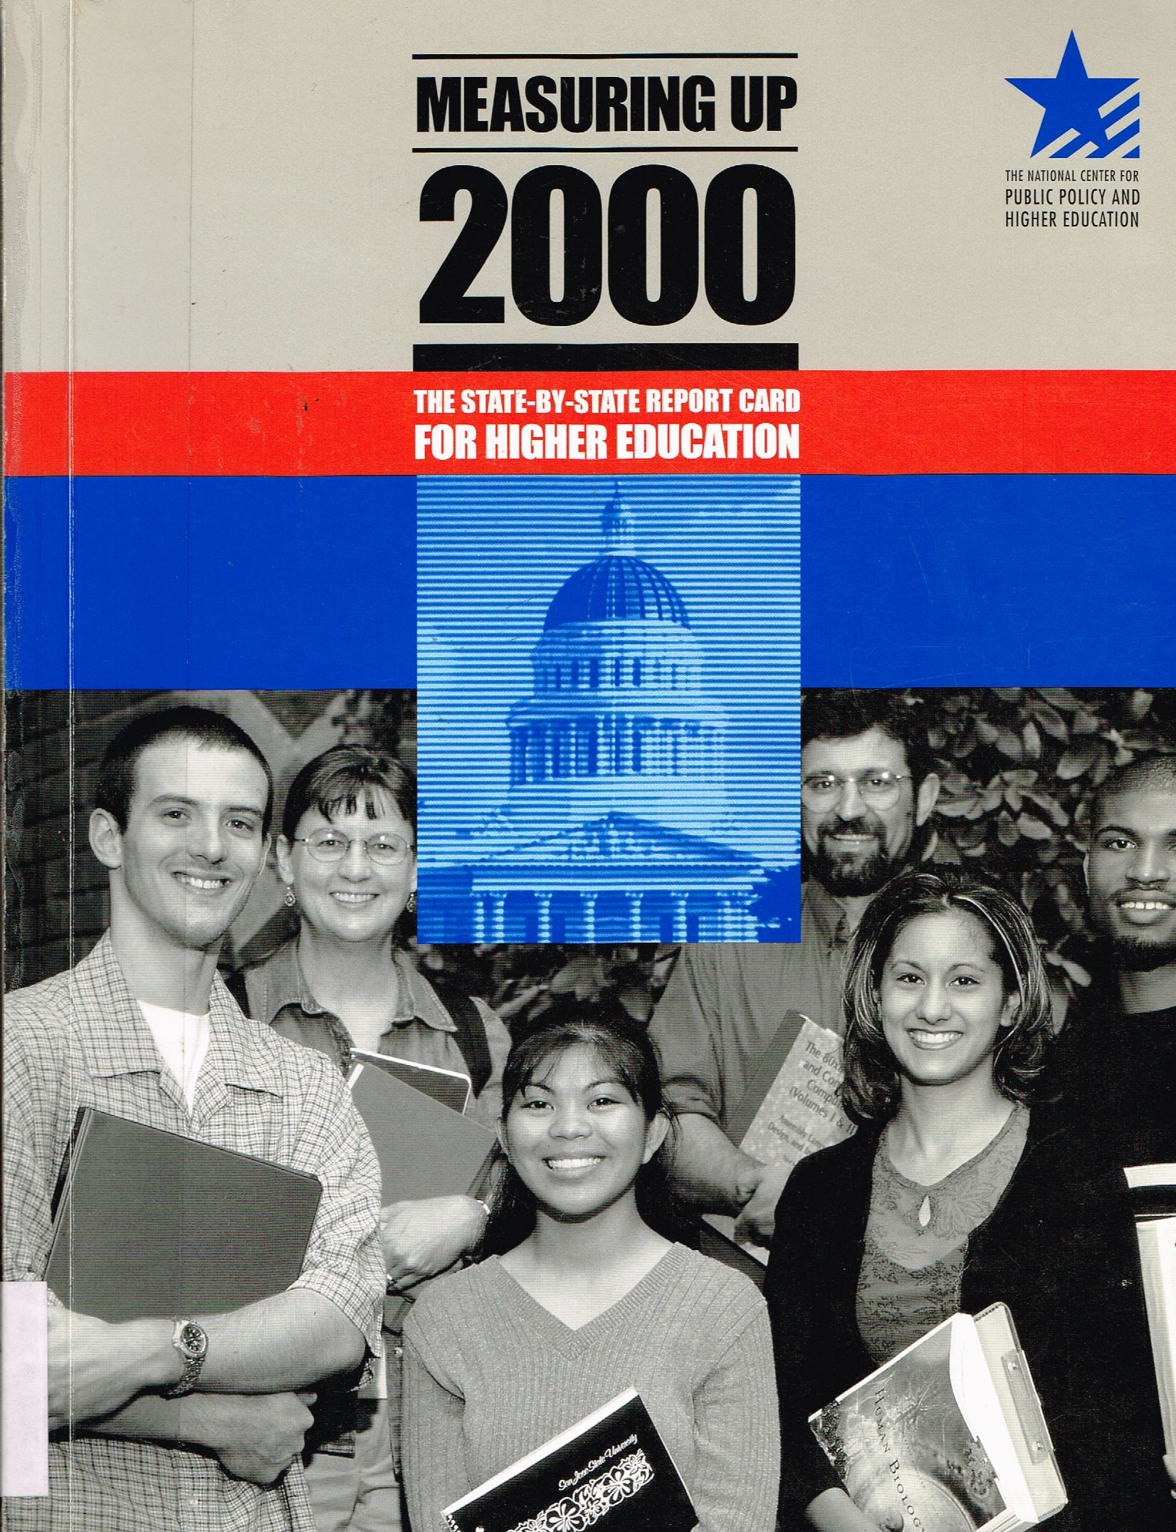
Milestones
Notes:
From 2000 to 2008 the national Center for Public Policy and Higher Education issued five biannual reports entitled Measuring Up, comparing higher education in all 50 states. This was an approach grounded through and through in data. Nothing subjective about it.

Slide 22
Measuring Up Performance Metrics
Preparation
Participation
Affordability
Completion
Benefits
Learning
Notes:
States were graded in six areas:
Preparation -- measures such as HS graduation rates and scores on college entrance exams
Participation – measures such as percentage of students who go on to college immediately after graduating from HS
Affordability – measures such as share of family income required after financial aid to attend public two-year and four-year colleges
Completion – proportion of students who complete degrees or certificates relative to the number who enroll
Benefits – measures of what we would now call educational attainment, proportion of adults with post-secondary credentials
Learning – what we would now call Learning Outcomes, that is, educational performance of students.
The Grading was strict and hard.
There were lots of bad grades– Ds and Fs – for many of the states. And not surprisingly people in the states that received those grades were pretty upset

Slide 23
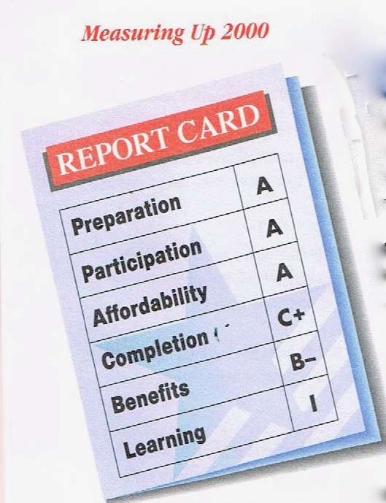
Illinois Grades: Measuring Up 2000
Notes:
As you can see, though, Illinois’ grades were strong.
PREPARATION: Grade of A
A very high proportion of Illinois’ young adults earn a high school diploma or a General Education Development (GED) diploma by age 24.Ilinois is the best performing state on the proportion of high school juniors and seniors who score well on college entrance exams.
PARTICIPATION: Grade of A
A very large percentage of students in Illinois go on to college immediately after high school, and a high proportion of young adults (ages18 to 24)are enrolled in education or training beyond high school. In addition, Illinois is a top-performing state in providing college-level education and training opportunities for its working-age adults (ages 25 to 44).
AFFORDABILITY. Grade of A
The report notes that Illinois was the best performing state in affordability defined as the share of family income required after financial aid, to attend public two-and four-year colleges
COMPLETION. Grade of C+
Fairly large proportions of Illinois’ students at two-and four-year colleges return for their second year. Also, a large percentage of first-time, full-time college students earn their bachelor’s degree within five years of enrolling. But only a FAIR proportion of students complete certificates and degrees relative to the number enrolled.
BENEFITS. Grade of B-
A large proportion of Illinois residents have a bachelor’s degree and this strengthens the state economically. A fairly large proportion of the state’s adults perform well on national assessments of high-level literacy.
LEARNING. Grade of Incomplete
Like other states, Illinois lacks information on the educational performance of students that would permit systematic state or national comparisons.
In fact, if you calculated a grade-point average the way it’s typically done by assigning numbers to the letter grades, what you find is that Illinois was ranked the highest among the 50 states.
That C- for Completion was troubling to the IBHE’s leadership and provided additional impetus to an initiative that had already been underway – called the Illinois Articulation Initiative -- to improve course transfer among colleges, but particularly between community colleges and the four year universities. It’s not unreasonable to think that the cumulative effort over decades to improve course transfer played a great role in Illinois NOW being the BEST IN THE NATION FOR COMPLETION RATES AT FOUR-YEAR INSTITUTIONS OF ALL COMMUNITY COLLEGE TRANSFER STUDENTS based on recently released data from the National Clearinghouse.
By the end of the first decade of this century, there was an increasing sense that it was time to take a comprehensive look at how higher ed was doing and what the direction should be for the future. That brings us to the next milestone.

Slide 24

Milestones
December 2008
Notes:
THE PUBLIC AGENDA FOR COLLEGE AND CAREER SUCCESS
This was the last master plan issued by the IBHE
House Joint Resolution 69 in the spring of 2007.
Task Force – 27 people, Broad representation– IBHE board chair, Carrie Hightman, served as TF chair.
In 2008 the board led extensive deliberation and collaboration with literally hundreds of stakeholders in higher education and the state economy.
To give you an Idea of the scope of that process: In 2008 there were
6 Task Force meetings
12 Regional Forums
2 public briefings
3 Legislative briefings
6 public hearings
…..ALL IN ONE YEAR
On December 9, 2008, the Board unanimously endorsed the Public Agenda as the blueprint to guide education policy – from preschool to graduate school – in Illinois for the next decade.
FULL CREDIT TO JUDY IRWIN, then IBHE Executive Director, FOR LEADING THIS EFFORT AND THE NCHEMS FOR SUBSTANTIAL CONTRIBUTIONS IN DATA COLLECTION AND PROCESS GUIDANCE

Slide 25
A Tale of Two States
Illinois needs effective and quality education for all people. The Illinois Public Agenda for College and Career Success will create one Illinois ready to face the future.
Notes:
Main Theme: A focus on equity
The report took a leaf out of Dicken's novel. and talked about Illinois as a tale of two states
One Illinois is well off, well educated, economically dynamic, with a seemingly bright future.
The other Illinois struggles to make ends meet, lags in educational attainment, and is economically stagnant.
Established Four Main Goals shown on the slide:
Increase educational attainment to match best performing states
Ensure college affordability for students, families, and taxpayers
Increase the number of high quality post-secondary credentials to meet the demands of the economy and an increasingly global society
Better integrate Illinois’ educational, research, and innovation assets to meet the economic needs of the state and its regions.
Each goal was accompanied by an analysis of the underlying problem and a set of recommendations to address those problems and to make progress on achieving the goal.
For the most part, the public agenda did not set up specific targets related to the goals and recommendations. Rather the report emphasized benchmarking against best performing states. But in terms of a specific quantitative target. there was ONE VERY SIGNIFICANT EXCEPTION.

Slide 26
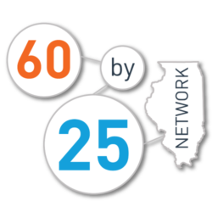
Notes:
Shortly after the Public Agenda was issued, the IBHE adopted an attainment goal: that by 2025 60% of the adult population would have a high quality certificate or college credential.
This goal really got people’s attention and has been used to underpin efforts to increase educational attainment across the state.

Slide 27
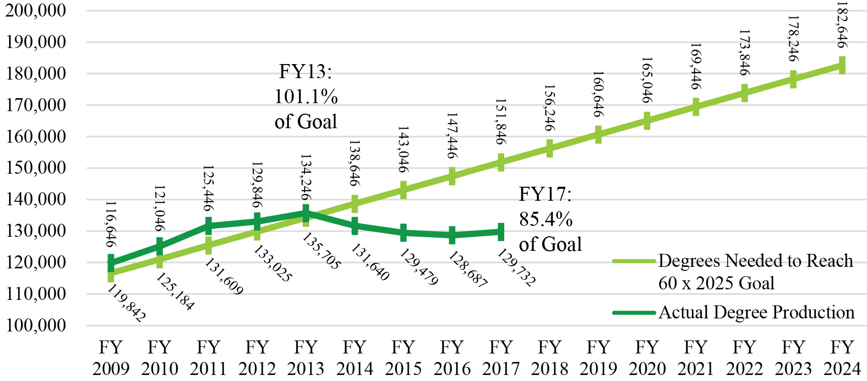
Illinois 60 x 2025 Goal
Notes:
You can see that in the several years immediately following the adoption of the Public Agenda, Illinois was on track to achieve the 60 by 25 goal.
Unfortunately, beginning in FY 2014, we began to slip and now we’re only producing graduates at about 85% of the number that would be needed to reach the goal by 2025.

Slide 28
Milestones
Pension Crisis and
“Real” Budget Reduction
Notes:
The final milestone I want to address is what has happened to the state budget for higher education over the past decade.

Slide 29
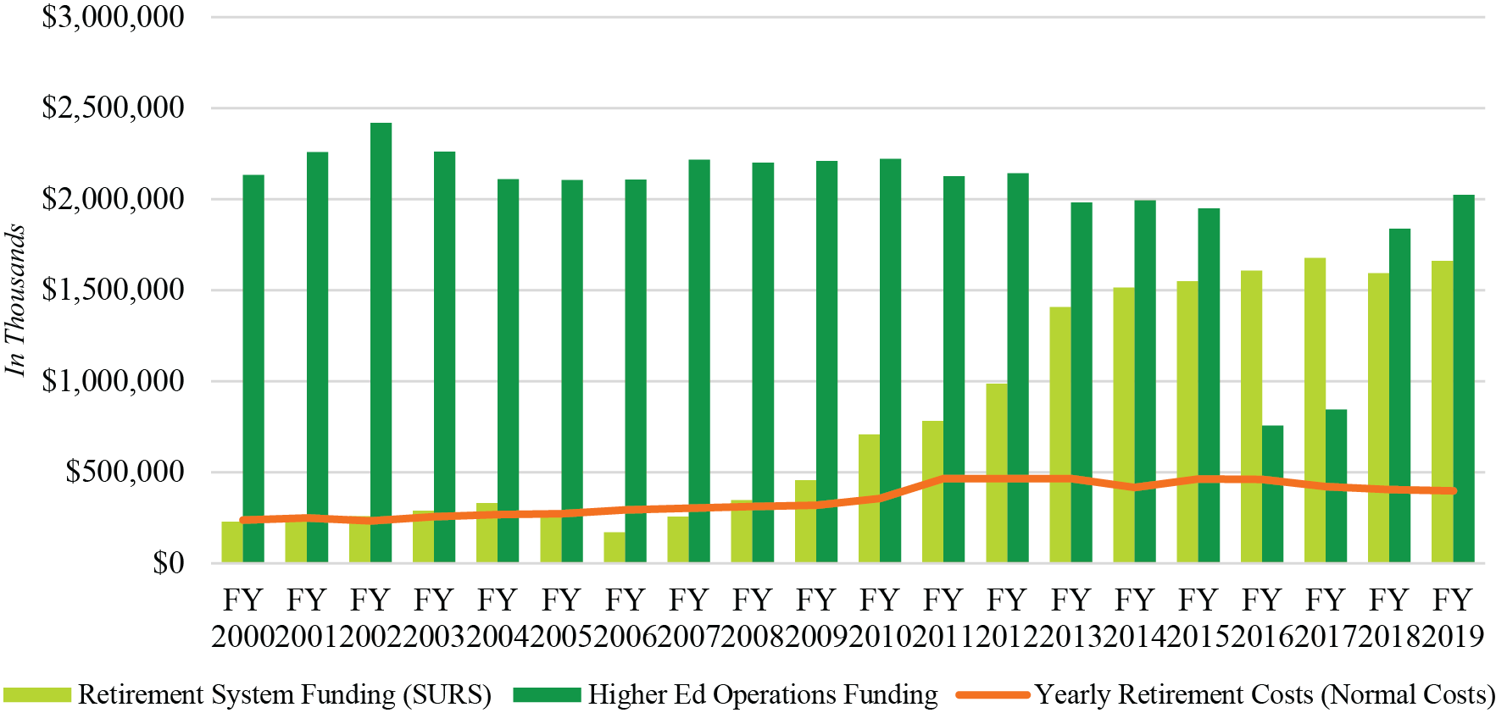
SURS Funding Compared to Higher Education Funding
Fiscal Years 2000 to 2009 (General Funds)
Notes:
As you can see, the mandated pension payment has increased dramatically in the past 10 years.
If we just focus on the budget for the operations of the public universities, the mandated pension payment actually exceeds the appropriation for all 12 public university campuses.
Incredible...

Slide 30
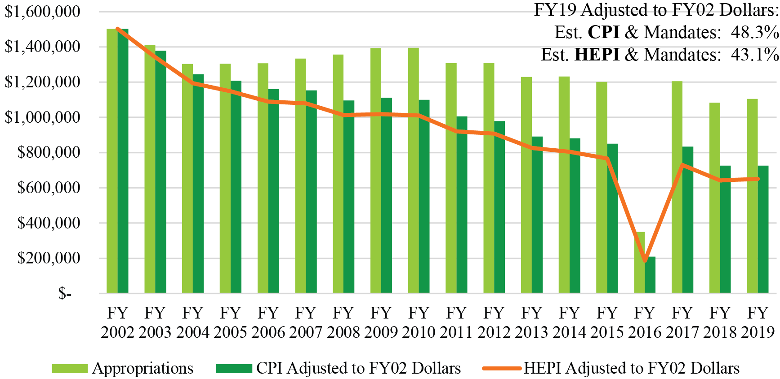
“Real” Funding Decline
Illinois Public University Appropriations History Adjusted for Mandates and Inflation (CPI and HEPI)
Notes:
On top of the way that pension payments affect the budget for higher education, we’ve got the issue of the purchasing power of the dollars that do get appropriated. When we adjust for inflation, we see that the appropriations for operations have declined precipitously in real terms.

Slide 31
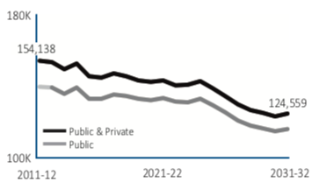
So where do we stand now?
A different demographic challenge
Illinois
5th Highest producer of high school graduates with 140,000 high school graduates, on average, projected per year between school years 2011-12 and 2031-32
The total number of graduates in Illinois is not projected to increase after 2011-12, ending at 124,600 in 2031-32
Source: Knocking at the College Door, 2016, WICCHE
Plus: Outmigration
Notes:
So where do we stand now?
The IBHE was born out of one demographic challenge and now we face a new demographic challenge
Even though Illinois produces a large number of high school graduates compared to many other states, the total number of HS graduates is on a steady decline.
Plus: Outmigration
Whether it’s the decline in the number of HS graduates or competition from other states, what we’ve seen in the past decade is a decline in the number of students attending our public universities. Over the past decade enrollement at Illinois public universities has declined from 202,147 in 2008 to 1883,833 in 2017 – the most recent data found on the IBHE website. That’s a 9% decline.
If I were a legislator I might wonder if the decline in funding is as awful as we, in higher ed, think it is given the fact that we’re serving nearly 10% fewer students in public universities than we were serving 10 years ago.

Slide 32
In light of the lessons learned from the past
Notes:
IN LIGHT OF THE LESSONS LEARNED FROM THE PAST.....
What do we need to be focusing on at this time?

Slide 33
So where do we stand now?
What is the best way to set statewide goals and strategies?
  How can we get the public universities, the privates, and the community colleges to collectively develop and work toward those goals?
What is going to be the IBHE’s strategy for working with the Legislature and the Governor and for restoring confidence in the IBHE as the leading voice for higher education in the state?
Notes:
1. As we’ve seen, in the past the IBHE led efforts to set statewide goals and strategies. The question now is: What is the best way to do that, that is, to set statewide goals and strategies and to coordinate higher education in the state in the environment we live in now?
And, implicit in that, How can we get the public universities, the privates, and the community colleges to work collectively to develop and work toward those goals?
2. A major lesson from the past relates the impact of positive relationships with legislators and with the governor.

